Slide 1
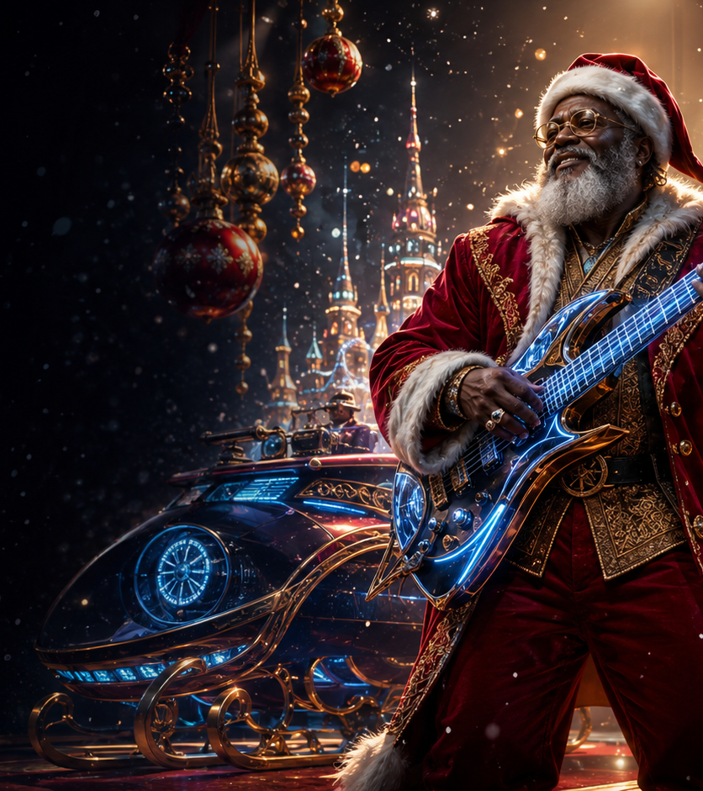
FEG · FLOYD ENTERTAINMENT GROUP
A SLAMMIN’
JAMMIN’
CHRISTMAS
A MUSICAL HOLIDAY FANTASY WITH SOUL
One man. Two lives. One Christmas that must find its spirit again.
Written by April Floyd & Eddie Floyd Jr.
Original music created by iconic soul legend Eddie Floyd
Seeking executive producers · directors · financing · distribution partners
CONFIDENTIAL DEVELOPMENT MATERIAL · CONCEPT ART · NO PERFORMERS ATTACHED
01 · FEGROUP.BIZ
Notes:
Position the film as a premium Black holiday fantasy with a music legacy, emotional stakes and franchise-ready worldbuilding.
[Sources]
- READY:SJCPDF(2).pdf supplied by April Floyd
- Creative and casting direction supplied by April Floyd, August 2026
- Generated concept art: OpenAI image generation; fictional unrecognizable people
[/Sources]

Slide 2
02
THE MOTION PICTURE
FEG · FLOYD ENTERTAINMENT GROUP
Christmas is running
out of spirit.
THE FEATURE-FILM PROMISE
Nick is a widowed father, the world’s Santa and a gifted musician who comes alive onstage. When his secret performances derail Christmas deliveries, belief collapses—and the Spirit Meter falls with him.
A chance meeting with single mother Justine and her music-loving son Jimmi leads Nick toward love, family history and a time-travel mission that could restore Christmas—and himself.
HIGH-CONCEPT HOLIDAY FANTASY · SOUL MUSIC
ROMANCE · FAMILY REDEMPTION
CONFIDENTIAL DEVELOPMENT MATERIAL · CONCEPT ART · NO PERFORMERS ATTACHED
02 · FEGROUP.BIZ
Notes:
Accurate screenplay logline: widowed Santa-musician Nick must repair belief after missed deliveries while finding love and confronting his family legacy.
[Sources]
- READY:SJCPDF(2).pdf supplied by April Floyd
- Creative and casting direction supplied by April Floyd, August 2026
- Generated concept art: OpenAI image generation; fictional unrecognizable people
[/Sources]

Slide 3
03
COMPARABLE FILMS
FEG · FLOYD ENTERTAINMENT GROUP
Black holiday stories have demonstrated theatrical demand.
SELECTED THEATRICAL COMPARISONS · NOMINAL DOLLARS
FILM
PRODUCTION
BUDGET
WORLDWIDE
BOX OFFICE
GROSS /
BUDGET
This Christmas
2007
$13.0M
$49.7M
3.8×
The Best Man Holiday
2013
$17.0M
$72.8M
4.3×
Almost Christmas
2016
$17.0M
$42.5M
2.5×
Tyler Perry’s A Madea Christmas
2013
$25.0M
$52.5M
2.1×
Observed range
These figures show audience precedent—not a performance guarantee. Gross-to-budget multiple is not net profit and excludes marketing, distribution fees and exhibitor share.
2.1×–4.3×
Source: The Numbers · accessed August 30, 2026
CONFIDENTIAL DEVELOPMENT MATERIAL · CONCEPT ART · NO PERFORMERS ATTACHED
03 · FEGROUP.BIZ
Notes:
The comparison set centers Black-led holiday ensemble films with publicly reported production budgets and theatrical grosses.
[Sources]
- The Numbers — This Christmas (2007): https://www.the-numbers.com/movie/This-Christmas
- The Numbers — The Best Man Holiday (2013): https://www.the-numbers.com/movie/Best-Man-Holiday-The
- The Numbers — Almost Christmas (2016): https://www.the-numbers.com/movie/Almost-Christmas
- The Numbers — Tyler Perry’s A Madea Christmas (2013): https://www.the-numbers.com/movie/Tyler-Perrys-A-Madea-Christmas
[/Sources]

Slide 4
04
ILLUSTRATIVE ROI MODEL
FEG · FLOYD ENTERTAINMENT GROUP
A transparent working model defines the break-even target.
EDITABLE PLANNING ASSUMPTIONS · NOT AN OFFER OR GUARANTEE
ASSUMPTIONS
SCENARIO
GROSS PRODUCER
RECEIPTS
NET TO
INVESTORS
ROI
Production budget
$6.0M
Delivery + launch reserve
$1.0M
Downside
$7.5M
$5.0M
-28.6%
Total investor capital
$7.0M
Target
$12.5M
$9.0M
+28.6%
Distribution / sales fee
20%
Recoupable distribution expenses
$1.0M
Upside
$20.0M
$15.0M
+114.3%
Investor break-even gross producer receipts
$10.0M
Formula: net to investors = (gross producer receipts × 80%) − $1.0M expenses. ROI = (net proceeds − $7.0M capital) ÷ $7.0M capital.
Model excludes taxes, tax incentives, interest, deferments, participations and any negotiated distribution waterfall. All assumptions must be replaced by the approved budget and signed deal terms.
CONFIDENTIAL DEVELOPMENT MATERIAL · CONCEPT ART · NO PERFORMERS ATTACHED
04 · FEGROUP.BIZ
Notes:
This is a working scenario model—not a forecast. Every input is editable when the production budget and distribution proposal are finalized.
[Sources]
- Internal arithmetic based on the visible slide assumptions; prepared August 30, 2026
- Creative and financing direction supplied by April Floyd
[/Sources]

Slide 5
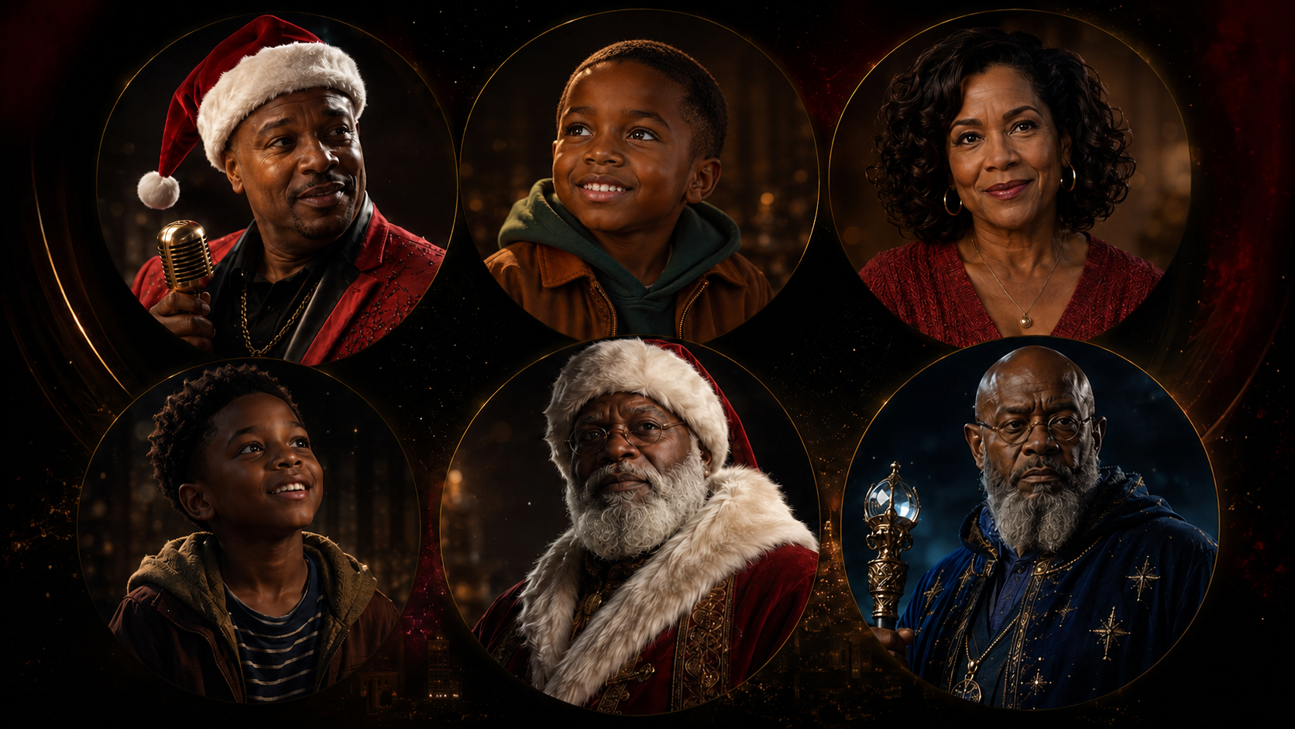
05
CHARACTERS & OPEN CASTING
FEG · FLOYD ENTERTAINMENT GROUP
A dynamic ensemble—with every role open.
FICTIONAL CONCEPT CHARACTERS · NO ACTORS ARE ATTACHED
SANTA NICK · CHRIS · JUSTINE · JIMI · SANTA DAVID · MR. WHINFIELD
PLUS A LARGE ENSEMBLE OF ELVES WHO RUN THE NORTH POLE, DRIVE THE COMEDY AND HELP SAVE CHRISTMAS
CONFIDENTIAL DEVELOPMENT MATERIAL · CONCEPT ART · NO PERFORMERS ATTACHED
05 · FEGROUP.BIZ
Notes:
Replace named perspective cast with open roles. Chris is depicted as a seven-year-old child, consistent with the screenplay and family concept. The elves are a major ensemble force, not background decoration.
[Sources]
- READY:SJCPDF(2).pdf supplied by April Floyd
- Creative and casting direction supplied by April Floyd, August 2026
- Generated concept art: OpenAI image generation; fictional unrecognizable people
[/Sources]

Slide 6
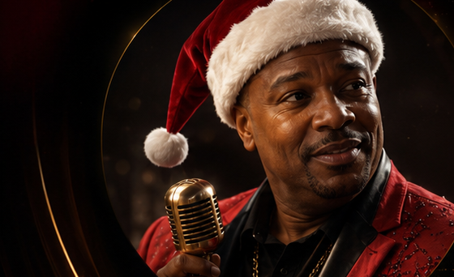

06
THE EMOTIONAL CONFLICT
FEG · FLOYD ENTERTAINMENT GROUP
Santa can give the world Christmas.
A father can still miss home.
SANTA NICK · CHRIS
Nick is a widowed single father carrying two inheritances: the Clause that makes him Santa and the music that makes him feel alive.
His seven-year-old son Chris loves music too, but does not know his father is Santa—or that he may one day inherit the role. Nick must unite fatherhood, duty and the soul he has kept divided.
A personal secret with generational—and global—consequences.
CONFIDENTIAL DEVELOPMENT MATERIAL · CONCEPT ART · NO PERFORMERS ATTACHED
06 · FEGROUP.BIZ
Notes:
The screenplay establishes Nick as a widowed single father and Chris as the future heir to the Santa legacy. Chris is consistently depicted as seven years old.
[Sources]
- READY:SJCPDF(2).pdf supplied by April Floyd
- Creative and casting direction supplied by April Floyd, August 2026
- Generated concept art: OpenAI image generation; fictional unrecognizable people
[/Sources]

Slide 7
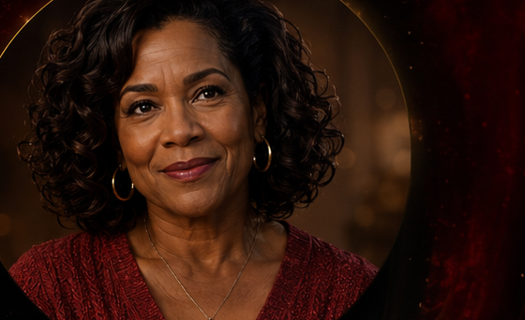
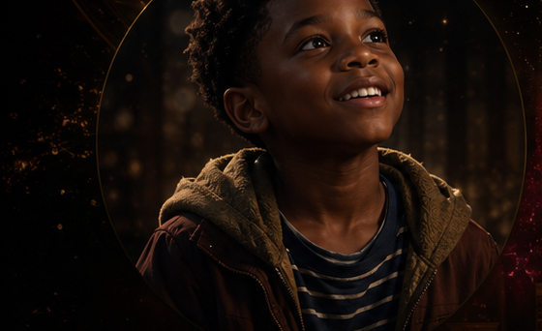
07
THE FAMILY STAKES
FEG · FLOYD ENTERTAINMENT GROUP
Two grieving families discover
a second chance.
JUSTINE · JIMMI
Justine is a resourceful single mother who lost Jimmi’s musician father and fears her son will someday choose the road over family.
Six-year-old Jimmi still believes in Santa, dreams of a real guitar and recognizes music as the bridge between Nick and their family. His wish opens the door; Justine’s courage makes the new family possible.
The romance grows from shared loss, laughter, music and parenthood—not rescue.
CONFIDENTIAL DEVELOPMENT MATERIAL · CONCEPT ART · NO PERFORMERS ATTACHED
07 · FEGROUP.BIZ
Notes:
The screenplay identifies Justine as a single mother whose child’s father died, and Nick as a widower raising Chris.
[Sources]
- READY:SJCPDF(2).pdf supplied by April Floyd
- Creative and casting direction supplied by April Floyd, August 2026
- Generated concept art: OpenAI image generation; fictional unrecognizable people
[/Sources]

Slide 8
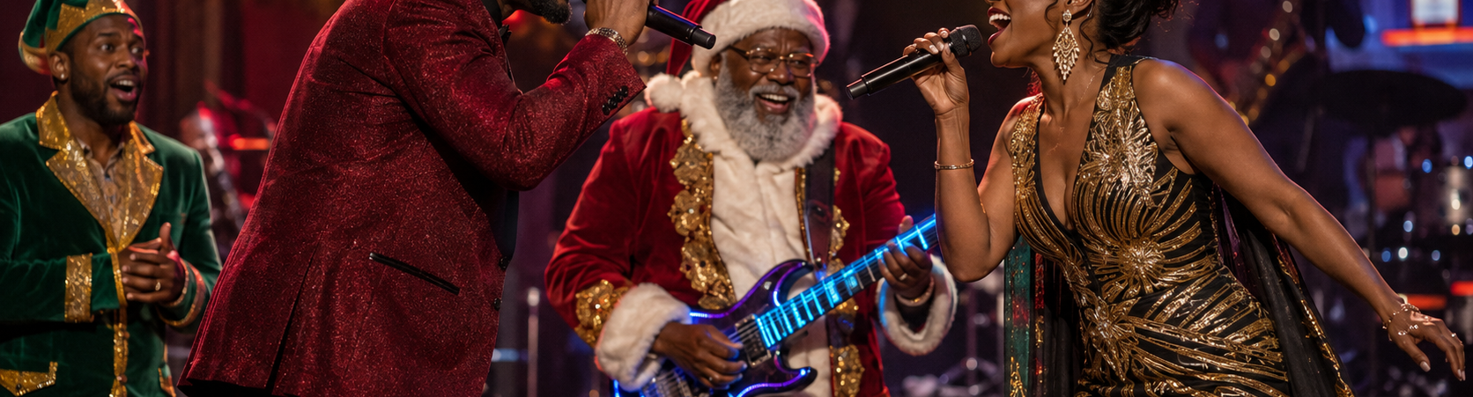
08
MUSIC & PERFORMANCE
FEG · FLOYD ENTERTAINMENT GROUP
The music does not decorate the story. It saves it.
ORIGINAL MUSIC CREATED BY ICONIC SOUL LEGEND EDDIE FLOYD
Known worldwide for “Knock on Wood,” Eddie Floyd brings authentic soul legacy to a Christmas fantasy designed for performance, soundtrack and repeat seasonal discovery.
Onstage, Nick’s hidden identity comes alive. The elves become witnesses, collaborators and comic truth-tellers—carrying the music from the stage back to the North Pole.
MUSIC · STORY · ELVES · LEGACY · SOUNDTRACK POTENTIAL
CONFIDENTIAL DEVELOPMENT MATERIAL · CONCEPT ART · NO PERFORMERS ATTACHED
08 · FEGROUP.BIZ
Notes:
Credit Eddie Floyd as the creator of the film music. Emphasize the elves as active musical and comic collaborators.
[Sources]
- READY:SJCPDF(2).pdf supplied by April Floyd
- Creative and casting direction supplied by April Floyd, August 2026
- Generated concept art: OpenAI image generation; fictional unrecognizable people
[/Sources]

Slide 9

09
THE STORY ENGINE
FEG · FLOYD ENTERTAINMENT GROUP
Santa’s spirit powers Christmas—
and the meter is falling.
THE CHRISTMAS SPIRIT METER
Patty reveals the rule: when Nick’s spirit drops, the meter falls—and while he is Santa, it falls even faster.
Sammy, Launa and the elves monitor the damage, freeze time, cover missed deliveries, guard the secret and help Nick seek answers. They keep Christmas moving until Santa becomes whole.
At the wedding, music and restored family finally ring the meter to full.
CONFIDENTIAL DEVELOPMENT MATERIAL · CONCEPT ART · NO PERFORMERS ATTACHED
09 · FEGROUP.BIZ
Notes:
The screenplay names it the Christmas Spirit Meter. Patty explains that Nick’s inner spirit directly controls it.
[Sources]
- READY:SJCPDF(2).pdf supplied by April Floyd
- Creative and casting direction supplied by April Floyd, August 2026
- Generated concept art: OpenAI image generation; fictional unrecognizable people
[/Sources]

Slide 10
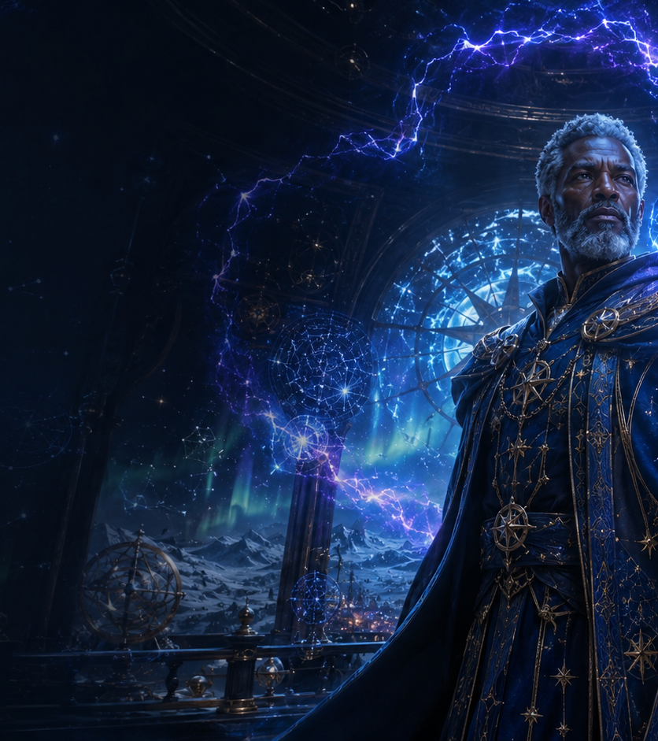
10
NORTH STAR MYTHOLOGY
FEG · FLOYD ENTERTAINMENT GROUP
The North Star has a guardian.
His help has a price.
MR. WHINFIELD · THE COAL ELVES
Whinfield and his coal-delivering elves protect the North Star in a hidden village where Christmas warmth has never reached.
Nick needs the Star to freeze time and find Santa David. Whinfield agrees only if his Head Elf joins the mission—and if Nick later brings Christmas, music and light to their world.
The bargain turns an enemy encounter into the film’s final act of reconciliation.
CONFIDENTIAL DEVELOPMENT MATERIAL · CONCEPT ART · NO PERFORMERS ATTACHED
10 · FEGROUP.BIZ
Notes:
Accurate screenplay mythology: Whinfield guards the North Star and negotiates a trade that leads to the final Christmas party and elf truce.
[Sources]
- READY:SJCPDF(2).pdf supplied by April Floyd
- Creative and casting direction supplied by April Floyd, August 2026
- Generated concept art: OpenAI image generation; fictional unrecognizable people
[/Sources]

Slide 11
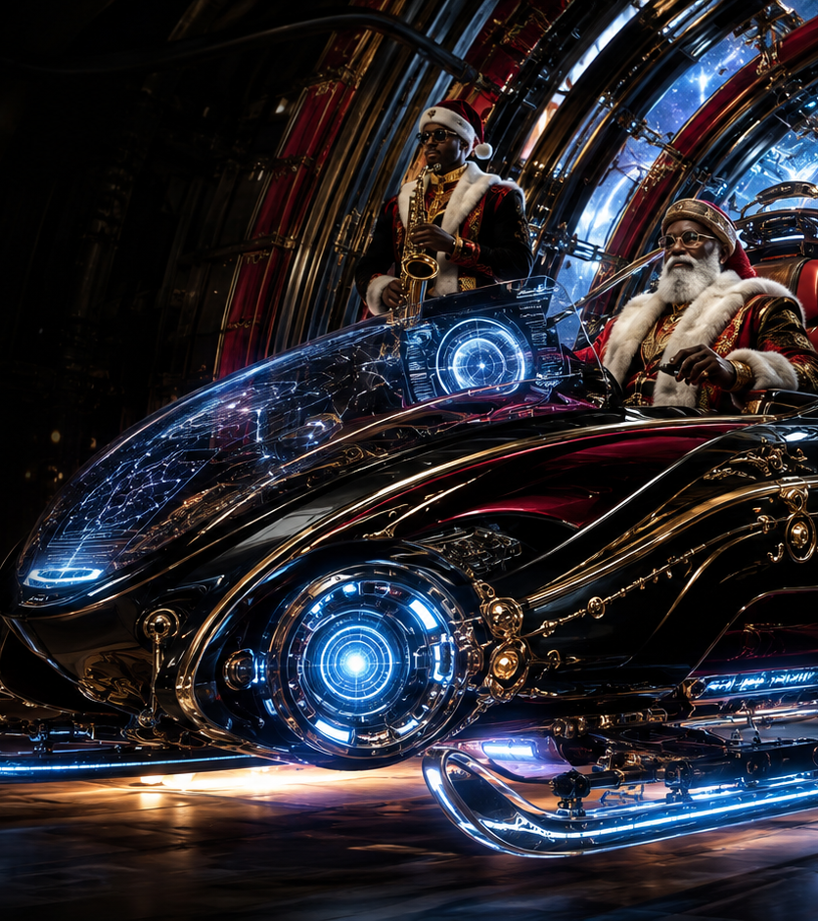
11
TIME TRAVEL
FEG · FLOYD ENTERTAINMENT GROUP
Nick must travel his bloodline
to understand the Clause.
THE NORTH STAR TIME-MACHINE SLEIGH
With the North Star powering the sleigh, Santa David takes his son through frozen time to uncover the family decisions that bound generations of men to Christmas.
The journey through Chicago, family memory and music history gives Nick the truth he needs: he does not have to abandon music to become a worthy father and Santa.
FUTURE TECHNOLOGY · BLACK SANTA LEGACY
MUSIC HISTORY · FATHERHOOD
CONFIDENTIAL DEVELOPMENT MATERIAL · CONCEPT ART · NO PERFORMERS ATTACHED
11 · FEGROUP.BIZ
Notes:
The screenplay uses the North Star to freeze time and power Santa David’s journey through Nick’s family history.
[Sources]
- READY:SJCPDF(2).pdf supplied by April Floyd
- Creative and casting direction supplied by April Floyd, August 2026
- Generated concept art: OpenAI image generation; fictional unrecognizable people
[/Sources]

Slide 12
12
THE INVITATION
FEG · FLOYD ENTERTAINMENT GROUP
One restored family reignites
an entire Christmas world.
A HOLIDAY FILM BUILT TO RETURN YEAR AFTER YEAR
Nick reveals the truth, unites Chris and Jimmi, marries Justine at the North Pole and rings the Spirit Meter to full through family and music.
He returns to Detroit, apologizes to the children he failed and gives young musicians the instruments they wished for. Then both elf communities celebrate, reconcile and jam together.
A SOULFUL BLACK CHRISTMAS FRANCHISE WITH MUSIC, MAGIC, ROMANCE AND LEGACY
SEEKING EXECUTIVE PRODUCERS · DIRECTORS · FINANCING · DISTRIBUTION
April Floyd · Floyd Entertainment Group · FEGROUP.BIZ
CONFIDENTIAL DEVELOPMENT MATERIAL · CONCEPT ART · NO PERFORMERS ATTACHED
12 · FEGROUP.BIZ
Notes:
The ending follows the screenplay: wedding, meter restored, Detroit redemption, instruments for youth and a truce celebration with Whinfield’s elves.
[Sources]
- READY:SJCPDF(2).pdf supplied by April Floyd
- Creative and casting direction supplied by April Floyd, August 2026
- Generated concept art: OpenAI image generation; fictional unrecognizable people
[/Sources]

